Slide 1
Advanced Counting Techniques
Chapter 8

Slide 2
Chapter Summary
Applications of Recurrence Relations
Solving Linear Recurrence Relations
Homogeneous Recurrence Relations
Nonhomogeneous Recurrence Relations
Generating Functions
Inclusion-Exclusion
Applications of Inclusion-Exclusion

Slide 3
Applications of Recurrence Relations
Section 8.1

Slide 4
Recurrence Relations (recalling definitions from Chapter 2)
Definition: A recurrence relation for the sequence {a_{n}} is an equation that expresses a_{n} in terms of one or more of the previous terms of the sequence, namely, a₀, a₁,…, a_{n-1}, for all integers n with n ≥ n₀, where n₀ is a nonnegative integer.
A sequence is called a solution of a recurrence relation if its terms satisfy the recurrence relation.
The initial conditions for a sequence specify the terms that precede the first term where the recurrence relation takes effect.

Slide 5
Rabbits and the Fibonacci Numbers
Example: A young pair of rabbits (one of each gender) is placed on an island.
A pair of rabbits does not breed until they are 2 months old. After they are 2 months old, each pair of rabbits produces another pair each month.
Find a recurrence relation for the number of pairs of rabbits on the island after n months, assuming that rabbits never die.
This is the original problem considered by Leonardo Pisano (Fibonacci) in the thirteenth century.

Slide 6
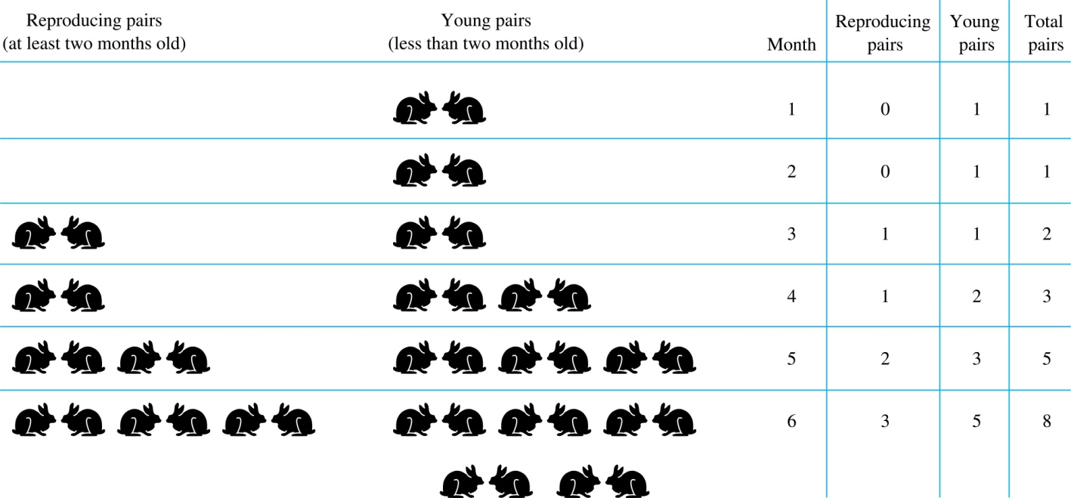
Rabbits and the Fiobonacci Numbers (cont.)
Modeling the Population Growth of Rabbits on an Island

Slide 7
Rabbits and the Fibonacci Numbers (cont.)
Solution: Let f_{n} be the the number of pairs of rabbits after n months.
There are f₁ = 1 pairs of rabbits on the island at the end of the first month.
We also have f₂ = 1 because the pair does not breed during the first month.
To find the number of pairs on the island after n months,
add the number on the island after the previous month, f_{n-1},
and the number of newborn pairs, which equals f_{n-2}, because each newborn pair comes from a pair at least two months old.
Consequently the sequence {f_{n} } satisfies the recurrence relation f_{n} = f_{n-1} + f_{n-2} for n ≥ 3 with the initial conditions f₁ = 1 and f₂ = 1.
The number of pairs of rabbits on the island after n months is given by the nth Fibonacci number.

Slide 8
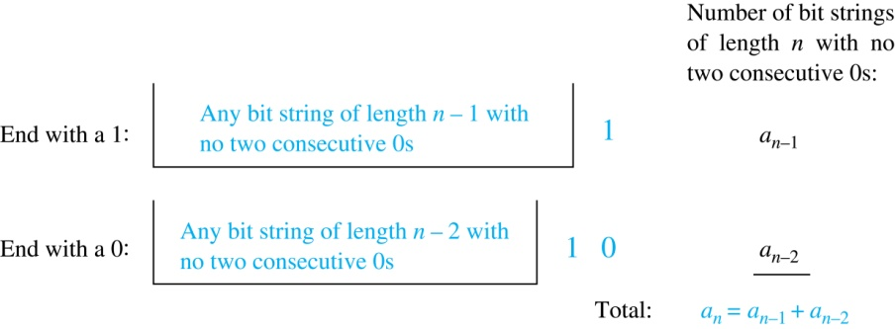
Counting Bit Strings
Example: Find a recurrence relation and give initial conditions for the number of bit strings of length n without two consecutive 0s. How many such bit strings are there of length five?
Solution: Let a_{n} denote the number of bit strings of length n without two consecutive 0s. To obtain a recurrence relation for {a_{n} } note that the number of bit strings of length n that do not have two consecutive 0s is the number of bit strings ending with a 0 plus the number of such bit strings ending with a 1.
Now assume that n ≥ 3.
The bit strings of length n ending with 1 without two consecutive 0s are the bit strings of length n −1 with no two consecutive 0s with a 1 added at the end. Hence, there are a_{n−1} such bit strings.
The bit strings of length n ending with 0 without two consecutive 0s are the bit strings of length n −2 with no two consecutive 0s with 10 at the end. Hence, there are a_{n−2} such bit strings.
We conclude that a_{n} = a_{n−1} + a_{n−2} for n ≥ 3.

Slide 9
Bit Strings (continued)
The initial conditions are:
a₁ = 2, since both the bit strings 0 and 1 do not have consecutive 0s.
a₂ = 3, since the bit strings 01, 10, and 11 do not have consecutive 0s, while 00 does.
To obtain a₅ , we use the recurrence relation three times to find that:
a₃ = a₂ + a₁ = 3 + 2 = 5
a₄ = a₃ + a₂ = 5+ 3 = 8
a₅ = a₄ + a₃ = 8+ 5 = 13
Note that {a_{n} } satisfies the same recurrence relation as the Fibonacci sequence. Since a₁ = f₃ and a₂ = f₄ , we conclude that a_{n} = f_{n+2} .

Slide 10
Solving Linear Recurrence Relations
Section 8.2

Slide 11
Section Summary
Linear Homogeneous Recurrence Relations
Solving Linear Homogeneous Recurrence Relations with Constant Coefficients.
Solving Linear Nonhomogeneous Recurrence Relations with Constant Coefficients.

Slide 12
Linear Homogeneous Recurrence Relations
Definition: A linear homogeneous recurrence relation of degree k with constant coefficients is a recurrence relation of the form a_{n} = c₁a_{n−1} + c₂a_{n−2} + ….. + c_{k} a_{n−k ,} where c₁, c₂, ….,c_{k} are real numbers, and c_{k} ≠ 0
it is linear because the right-hand side is a sum of the previous terms of the sequence each multiplied by a function of n.
it is homogeneous because no terms occur that are not multiples of the a_{j}s. Each coefficient is a constant.
the degree is k because a_{n} is expressed in terms of the previous k terms of the sequence.
By induction, a sequence satisfying such a recurrence relation is uniquely determined by the recurrence relation and the k initial conditions a₀ = C₁, a₀ = C₁ ,… , a_{k−1} = C_{k−1}.

Slide 13
Linear Homogeneous Recurrence Relations
Assume {b_{n}} and {d_{n}} are solutions of the linear homogeneous recurrence relation of degree k with constant coefficients a_{n} = c₁a_{n−1} + c₂a_{n−2} + ….. + c_{k} a_{n−k}
Then, α₁ b_{n} + α₂ d_{n} is also a solution of this recurrence relation.

Slide 14
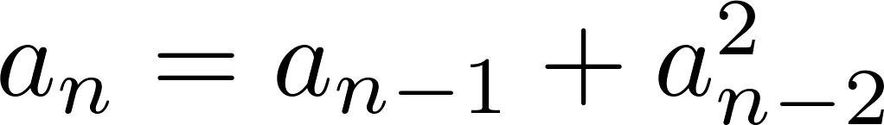
Examples of Linear Homogeneous Recurrence Relations
P_{n} = (1.11)P_{n-1} linear homogeneous recurrence relation of degree one
f_{n} = f_{n-1} + f_{n-2} linear homogeneous recurrence relation of degree two
not linear
H_{n} = 2H_{n−1} + 1 not homogeneous
B_{n} = nB_{n−1} coefficients are not constants

Slide 15
Solving Linear Homogeneous Recurrence Relations
The basic approach is to look for solutions of the form a_{n} = r^{n}, where r is a constant.
Note that a_{n} = r^{n} is a solution to the recurrence equation a_{n} = c₁a_{n−1} + c₂a_{n−2} + ⋯ + c_{k} a_{n−k} if and only if r^{n} = c₁r^{n−1} + c₂r^{n−2} + ⋯ + c_{k} r^{n−k} .
Algebraic manipulation yields the characteristic equation:
r^{k} − c₁r^{k−1} − c₂r^{k−2} − ⋯ − c_{k−1}r − c_{k} = 0
The sequence {a_{n}} with a_{n} = r^{n} is a solution if and only if r is a solution to the characteristic equation.
The solutions to the characteristic equation are called the characteristic roots of the recurrence relation. The roots are used to give an explicit formula for all the solutions of the recurrence relation.

Slide 16
Solving Linear Homogeneous Recurrence Relations of Degree Two
Theorem 1: Let c₁ and c₂ be real numbers. Suppose that r² – c₁r – c₂ = 0 has two distinct roots r₁ and r₂. Then the sequence {a_{n}} is a solution to the recurrence relation a_{n} = c₁a_{n−1} + c₂a_{n−2} with initial conditions if and only if
for n = 0,1,2,… , where α₁ and α₂ are constants.
This direct solution can represent all the possible sequences verifying a_{n} = c₁a_{n−1} + c₂a_{n−2}.

Slide 17
Solving Linear Homogeneous Recurrence Relations of Degree Two
Proof: The roots (r₁)^{n} and (r₂)^{n} are solutions of the recurrence equation.
Thus, α₁(r₁)^{n} + α₂(r₂)^{n} with arbitrary α₁, α₂ is also a solution of the recurrence equation.
- Moreover, if r₁ ≠ r₂, we can find uniquely α₁ and α₂ in order to verify the initial conditions (IC), α₁ + α₂ = a₀ and α₁ r₁ + α₂r₂ = a₁. Thus, α₁(r₁)^{n} + α₂(r₂)^{n} verifies the recurrence relation for n = 0,1.
- Then, since, for a given set of IC, the sequence {a_{n}} for n = 2,… is determined uniquely by a_{n} = c₁a_{n−1} + c₂a_{n−2} and α₁(r₁)^{n} + α₂(r₂)^{n} verifies exactly the recurrence equation a_{n} = c₁a_{n−1} + c₂a_{n−2} for the same initial conditions, we must have
for n = 0,1,2,… , where α₁ and α₂ are set by the IC.

Slide 18
Using Theorem 1
Example: What is the solution to the recurrence relation
a_{n} = a_{n−1} + 2a_{n−2} with a₀ = 2 and a₁ = 7?
Solution: The characteristic equation is r² − r − 2 = 0.
Its roots are r = 2 and r = −1 . Therefore, {a_{n}} is a solution to the recurrence relation if and only if a_{n} = α₁2^{n} + α₂(−1)^{n}, for some constants α₁ and α₂.
To find the constants α₁ and α₂, note that
a₀ = 2 = α₁ + α₂ and a₁ = 7 = α₁2 + α₂(−1).
Solving these equations, we find that α₁ = 3 and α₂ = −1.
Hence, the solution is the sequence {a_{n}} with a_{n} = 3∙2^{n} − (−1)^{n}.

Slide 19
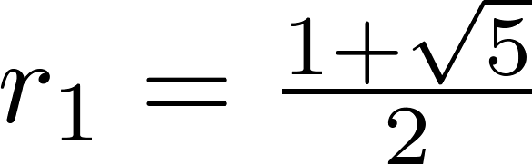
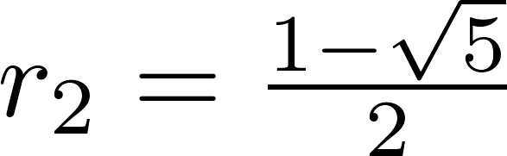
An Explicit Formula for the Fibonacci Numbers
We can use Theorem 1 to find an explicit formula for the Fibonacci numbers. The sequence of Fibonacci numbers satisfies the recurrence relation f_{n} = f_{n−1} + f_{n−2} with the initial conditions: f₀ = 0 and f₁ = 1.
Solution: The roots of the characteristic equation r² – r – 1 = 0 are

Slide 20
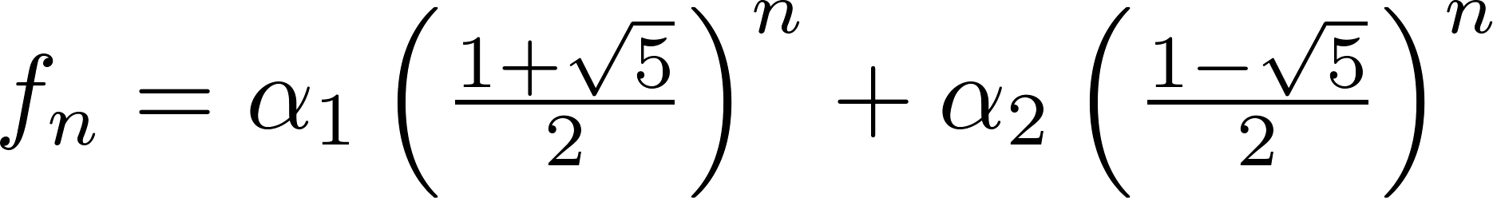
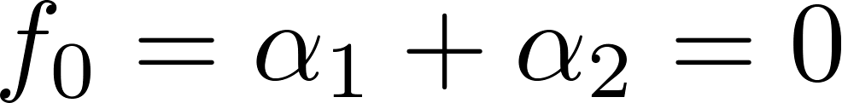
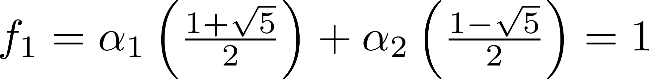
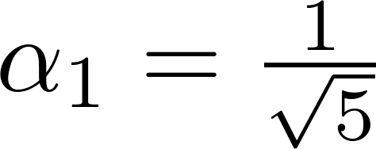
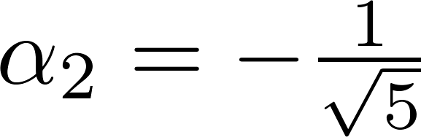
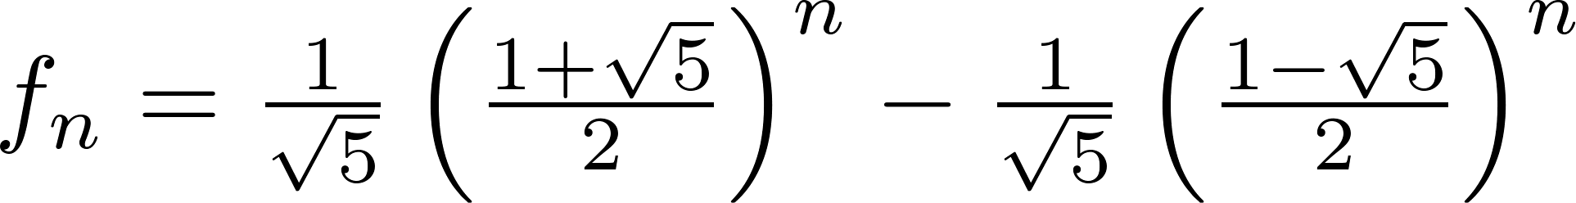
Fibonacci Numbers (continued)
Therefore by Theorem 1
for some constants α₁ and α₂.
Using the initial conditions f₀ = 0 and f₁ = 1 , we have
Solving, we obtain .
Hence,
.
,

Slide 21
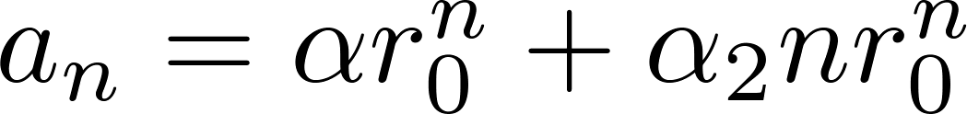
The Solution when there is a Repeated Root
Theorem 2: Let c₁ and c₂ be real numbers with c₂ ≠ 0. Suppose that r² – c₁r – c₂ = 0 has one repeated root r₀. Then the sequence {a_{n}} is a solution to the recurrence relation a_{n} = c₁a_{n−1} + c₂a_{n−2} if and only if
for n = 0,1,2,… , where α₁ and α₂ are constants.

Slide 22
Using Theorem 2
Example: What is the solution to the recurrence relation a_{n} = 6a_{n−1} − 9a_{n−2} with a₀ = 1 and a₁ = 6?
Solution: The characteristic equation is r² − 6r + 9 = 0.
The only root is r = 3. Therefore, {a_{n}} is a solution to the recurrence relation if and only if
a_{n} = α₁3^{n} + α₂n(3)^{n}
where α₁ and α₂ are constants.
To find the constants α₁ and α₂, note that
a₀ = 1 = α₁ and a₁ = 6 = α₁ ∙ 3 + α₂ ∙ 3.
Solving, we find that α₁ = 1 and α₂ = 1.
Hence,
a_{n} = 3^{n} + n3^{n} .

Slide 23
Solving Linear Homogeneous Recurrence Relations of Arbitrary Degree
This theorem can be used to solve linear homogeneous recurrence relations with constant coefficients of any degree when the characteristic equation has distinct roots.
Theorem 3: Let c₁, c₂ ,…, c_{k} be real numbers. Suppose that the characteristic equation
r^{k} – c₁r^{k−1} –⋯ – c_{k} = 0
has k distinct roots r₁, r₂, …, r_{k}. Then a sequence {a_{n}} is a solution of the recurrence relation
a_{n} = c₁a_{n−1} + c₂a_{n−2} + ….. + c_{k} a_{n−k}
if and only if
for n = 0, 1, 2, …, where α₁, α₂,…, α_{k} are constants.

Slide 24
The General Case with Repeated Roots Allowed
Theorem 4: Let c₁, c₂ ,…, c_{k} be real numbers. Suppose that the characteristic equation
r^{k} – c₁r^{k−1} –⋯ – c_{k} = 0
has t distinct roots r₁, r₂, …, r_{t} with multiplicities m₁, m₂, …, m_{t}, respectively so that m_{i} ≥ 1 for i = 0, 1, 2, …,t and m₁ + m₂ + … + m_{t} = k. Then a sequence {a_{n}} is a solution of the recurrence relation
a_{n} = c₁a_{n−1} + c₂a_{n−2} + ….. + c_{k} a_{n−k}
if and only if
for n = 0, 1, 2, …, where α_{i,j} are constants for 1≤ i ≤ t and 0≤ j ≤ m_{i−1}.

Slide 25
Linear Nonhomogeneous Recurrence Relations with Constant Coefficients
Definition: A linear nonhomogeneous recurrence relation with constant coefficients is a recurrence relation of the form:
a_{n} = c₁a_{n−1} + c₂a_{n−2} + ….. + c_{k} a_{n−k} + F(n) ,
where c₁, c₂, ….,c_{k} are real numbers, and F(n) is a function not identically zero depending only on n: the source term
The recurrence relation
a_{n} = c₁a_{n−1} + c₂a_{n−2} + ….. + c_{k} a_{n−k ,}
is called the associated homogeneous recurrence relation.

Slide 26
Linear Nonhomogeneous Recurrence Relations with Constant Coefficients (cont.)
The following are linear nonhomogeneous recurrence relations with constant coefficients:
a_{n} = a_{n−1} + 2^{n} ,
a_{n} = a_{n−1} + a_{n−2} + n² + n + 1,
a_{n} = 3a_{n−1} + n3^{n} ,
a_{n} = a_{n−1} + a_{n−2} + a_{n−3} + n!
where the following are the associated linear homogeneous recurrence relations, respectively:
a_{n} = a_{n−1 ,}
a_{n} = a_{n−1} + a_{n−2},
a_{n} = 3a_{n−1} ,
a_{n} = a_{n−1} + a_{n−2} + a_{n−3}

Slide 27
Solving Linear Nonhomogeneous Recurrence Relations with Constant Coefficients
Theorem 5: If {a_{n}^{(p)}} is a particular solution of the nonhomogeneous linear recurrence relation with constant coefficients
a_{n} = c₁a_{n−1} + c₂a_{n−2} + ⋯ + c_{k} a_{n−k} + F(n) ,
then every solution is of the form {a_{n}^{(p)} + a_{n}^{(h)}}, where {a_{n}^{(h)}} is the general solution of the associated homogeneous recurrence relation
a_{n} = c₁a_{n−1} + c₂a_{n−2} + ⋯ + c_{k} a_{n−k .}

Slide 28
Solving Linear Nonhomogeneous Recurrence Relations with Constant Coefficients
Proof: Let {a_{n}^{(p)}} be a particular solution of a_{n}^{(p)} = c₁a_{n−1}^{(p)} + c₂a_{n−2}^{(p)} + ⋯ + c_{k} a_{n−k}^{(p)} + F(n) with the corresponding IC
– Let {b_{n}} be any other solution of the form b_{n} = c₁b_{n−1} + c₂b_{n−2} + ⋯ + c_{k} b_{n−k} + F(n)
– We thus have that (b_{n} – a_{n}^{(p)}) = c₁ (b_{n–1} – a_{n–1}^{(p)}) + c₂ (b_{n–2} – a_{n–2}^{(p)}) + ⋯ + c_{k} (b_{n–k} – a_{n–k}^{(p)}) which is linear homogeneous with general solution {a_{n}^{(h)}}
– Therefore (b_{n} – a_{n}^{(p)}) = a_{n}^{(h)} and {b_{n}} must be of the form
b_{n} = a_{n}^{(p)} + a_{n}^{(h)}, where {a_{n}^{(h)}} is a solution of the associated homogeneous recurrence relation
a_{n} = c₁a_{n−1} + c₂a_{n−2} + ⋯ + c_{k} a_{n−k .}

Slide 29
Solving Linear Nonhomogeneous Recurrence Relations with Constant Coefficients (continued)
Example: Find all solutions of the recurrence relation a_{n} = 3a_{n−1} + 2n.
What is the solution with a₁ = 3?
Solution: The associated linear homogeneous equation is a_{n} = 3a_{n−1}.
Its solutions are a_{n}^{(h)} = α3^{n}, where α is a constant.
Because F(n)= 2n is a polynomial in n of degree one, to find a particular solution we might try a linear function in n, say p_{n} = cn + d, where c and d are constants. Suppose that p_{n} = cn + d is such a solution.
Then a_{n} = 3a_{n−1} + 2n becomes cn + d = 3(c(n− 1) + d)+ 2n.
Simplifying yields (2 + 2c)n + (2d − 3c) = 0. It follows that cn + d is a solution if and only if
2 + 2c = 0 and 2d − 3c = 0. Therefore, cn + d is a solution if and only if c = − 1 and d = − 3/2.
Consequently, a_{n}^{(p)} = −n − 3/2 is a particular solution.
By Theorem 5, all solutions are of the form a_{n} = a_{n}^{(p)} + a_{n}^{(h)} = −n − 3/2 + α3^{n}, where α is a constant.
To find the solution with a₁ = 3, let n = 1 in the above formula for the general solution.
Then 3 = −1 − 3/2 + 3 α, and α = 11/6. Hence, the solution is a_{n} = −n − 3/2 + (11/6)3^{n}.

Slide 30
Solving Recurrence Relations using substitution
Using the idea of substitution helps in solving recurrence relations. The following two examples illustrate this.

Slide 31
Example
Solve the recurrence relation a_{n}² − 2a_{n −1}² = 1 for n ≥ 1 where a₀ = 1.
This is a nonlinear equation. This can be converted to a linear equation by using the substitution b_{n} = a_{n}². Now the equation becomes b_{n} − 2b_{n −1} = 1 with b₀ = a₀² = 1² = 1.
Solving b_{n} − 2b_{n −1} = 1 with b₀ = 1 the homogeneous solution is a2^{n} and the particular solution is c. So b_{n} = a2^{n} + c where a and c are constants. Using the fact that b₀ = 1 and b₁ = 3 we get a + c = 1 and 2a + c = 3, which gives a = 2 and b = −1. Hence the solution is b_{n} = 2⋅2^{n} −1 = 2^{n+1} −1.
Substituting back a_{n}² = 2^{n+1} −1
Even though since a₀ = 1, a_{n} cannot be − .

Slide 32
The state-space approach

Slide 33
The state-space approach
We have the recurrence equation:
Let us put it in vector/matrix form:

Slide 34
The state-space approach
We also define the matrix of coefficients:
We thus obtain a first-order equation:

Slide 35
The state-space approach
with the initial condition at n = 0:
Let us try to solve this vector equation

Slide 36
The state-space approach
From which we infer that
Which is the solution

Slide 37
Generating Functions
Section 8.4

Slide 38
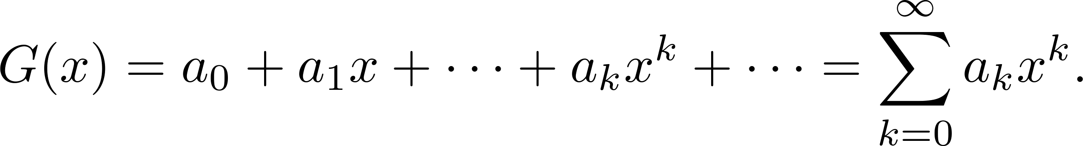
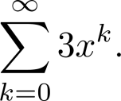
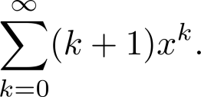
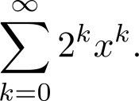
Generating Functions
Definition: The generating function for the sequence a₀, a₁,…, a_{k}, … of real numbers is the infinite series
Examples:
The sequence {a_{k}} with a_{k} = 3 has the generating function
The sequence {a_{k}} with a_{k} = k + 1 has the generating function has the generating function
The sequence {a_{k}} with a_{k} = 2^{k} has the generating function has the generating function

Slide 39
Generating Functions for Finite Sequences
Generating functions for finite sequences of real numbers can be defined by extending a finite sequence a₀,a₁, … , a_{n} into an infinite sequence by setting a_{n+1} = 0, a_{n+2} = 0, and so on.
The generating function G(x) of this infinite sequence {a_{n}} is a polynomial of degree n because no terms of the form a_{j}x^{j} with j > n occur, that is,
G(x) = a₀ + a₁x + ⋯ + a_{n} x^{n}.

Slide 40
Generating Functions for Finite Sequences (continued)
Example: What is the generating function for the sequence 1,1,1,1,1,1?
Solution: The generating function of 1,1,1,1,1,1 is
1 + x + x² + x³ + x⁴ + x⁵.
By Theorem 1 of Section 2.4, we have
(x⁶ − 1)/(x −1) = 1 + x + x² + x³ + x⁴ + x⁵
when x ≠ 1.
Consequently G(x) = (x⁶ − 1)/(x −1) is the generating function of the sequence.

Slide 41
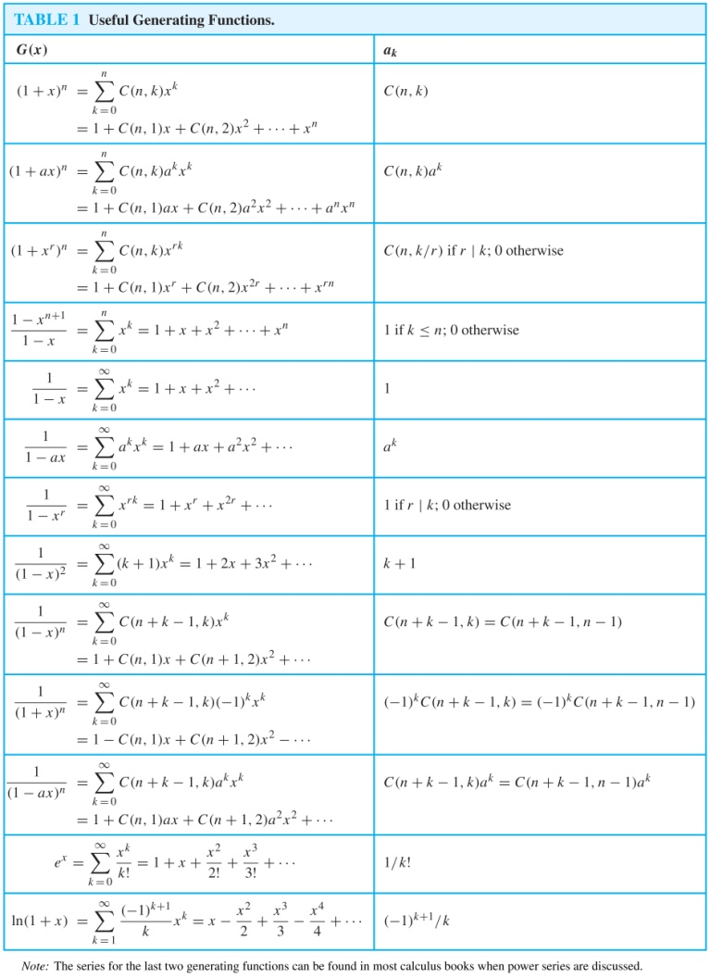
Useful Generating Functions

Slide 42
Counting Problems and Generating Functions
Example: Find the number of solutions of
e₁ + e₂ + e₃ = 17,
where e₁, e₂, and e₃ are nonnegative integers with
2 ≤ e₁≤ 5, 3 ≤ e₂ ≤ 6, and 4 ≤ e₃ ≤ 7.
Solution: The number of solutions is the coefficient of x¹⁷ in the expansion of
(x² + x³ + x⁴ + x⁵) (x³ + x⁴ + x⁵ + x⁶) (x⁴ + x⁵ + x⁶ + x⁷).
This follows because a term equal to is obtained in the product by picking a term in the first sum x^{e1}, a term in the second sum x^{e2}, and a term in the third sum x^{e3}, where e₁ + e₂ + e₃ = 17.
There are three solutions since the coefficient of x¹⁷ in the product is 3.

Slide 43
Inclusion-Exclusion
Section 8.5

Slide 44
Principle of Inclusion-Exclusion
In Section 2.2, we developed the following formula for the number of elements in the union of two finite sets:
We will generalize this formula to finite sets of any size.

Slide 45
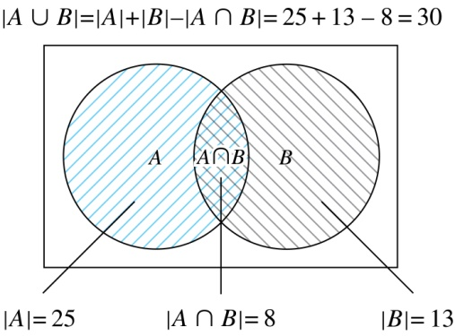
Two Finite Sets
Example: In a discrete mathematics class every student is a major in computer science or mathematics or both. The number of students having computer science as a major (possibly along with mathematics) is 25; the number of students having mathematics as a major (possibly along with computer science) is 13; and the number of students majoring in both computer science and mathematics is 8. How many students are in the class?
Solution: |A∪B| = |A| + |B| −|A∩B|
= 25 + 13 −8 = 30

Slide 46
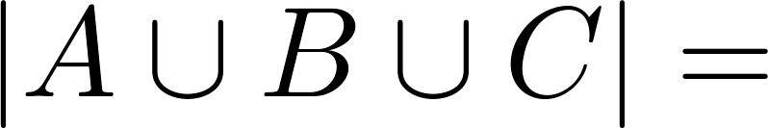
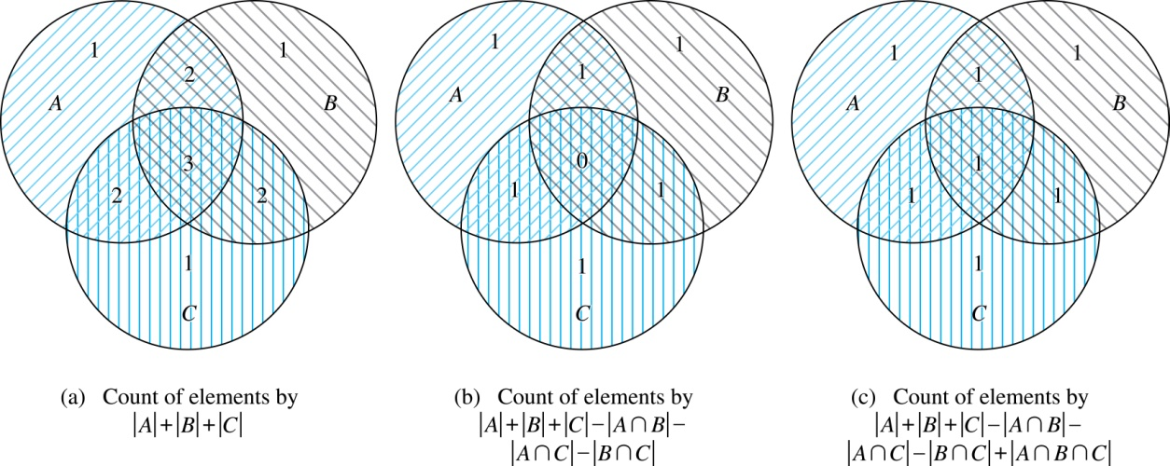
Three Finite Sets

Slide 47
Three Finite Sets Continued
Example: A total of 1232 students have taken a course in Spanish, 879 have taken a course in French, and 114 have taken a course in Russian. Further, 103 have taken courses in both Spanish and French, 23 have taken courses in both Spanish and Russian, and 14 have taken courses in both French and Russian. If 2092 students have taken a course in at least one of Spanish French and Russian, how many students have taken a course in all 3 languages.
Solution: Let S be the set of students who have taken a course in Spanish, F the set of students who have taken a course in French, and R the set of students who have taken a course in Russian. Then, we have
|S| = 1232, |F| = 879, |R| = 114, |S∩F| = 103, |S∩R| = 23, |F∩R| = 14, and |S∪F∪R| = 2092.
Using the equation
|S∪F∪R| = |S|+ |F|+ |R| − |S∩F| − |S∩R| − |F∩R| + |S∩F∩R|,
we obtain 2092 = 1232 + 879 + 114 −103 −23 −14 + |S∩F∩R|.
Solving for |S∩F∩R| yields 7.

Slide 48
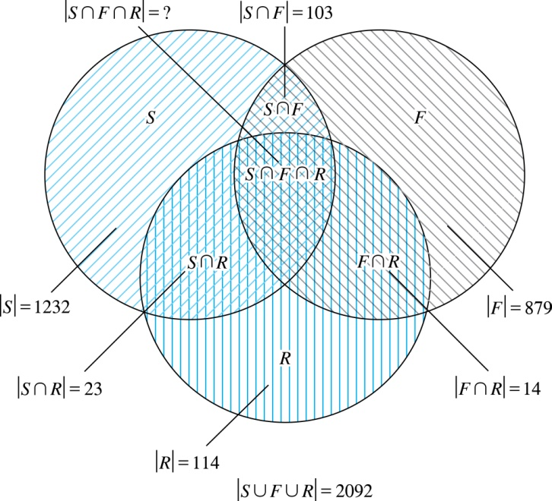
Illustration of Three Finite Set Example

Slide 49
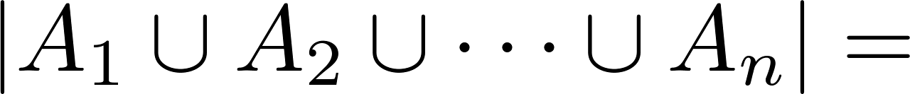
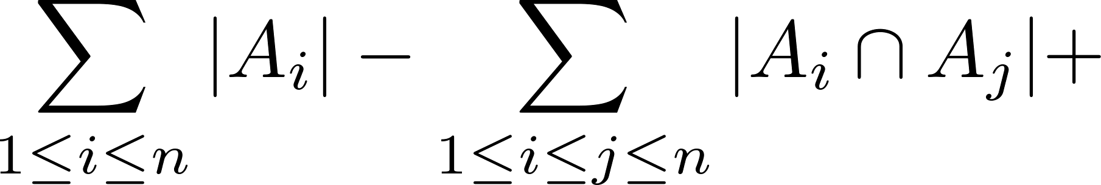
The Principle of Inclusion-Exclusion
Theorem 1. The Principle of Inclusion-Exclusion: Let A₁, A₂, …, A_{n} be finite sets. Then:

Slide 50
The Principle of Inclusion-Exclusion (continued)
Proof: An element in the union has to be counted exactly once in the right-hand side of the equation. Consider an element a that is a member of r of the sets A₁,…., A_{n}, where 1≤ r ≤ n.
What is the number of combinations of these r sets?
It is counted C(r,1) times by Σ|A_{i}|
It is counted C(r,2) times by Σ|A_{i} ⋂A_{j}|
In general, it is counted C(r,m) times by the summation of m of the sets A_{i}.

Slide 51
The Principle of Inclusion-Exclusion (continued)
Thus the element is counted exactly
C(r,1) − C(r,2) + C(r,3) − ⋯ + (−1)^{r+1} C(r,r)
times by the right hand side of the equation.
By Corollary 2 of Section 6.4, we have
C(r,0) − C(r,1) + C(r,2) − ⋯ + (−1)^{r} C(r,r) = 0.
Hence,
1 = C(r,0) = C(r,1) − C(r,2) + ⋯ + (−1)^{r+1} C(r,r).

